Slide 1
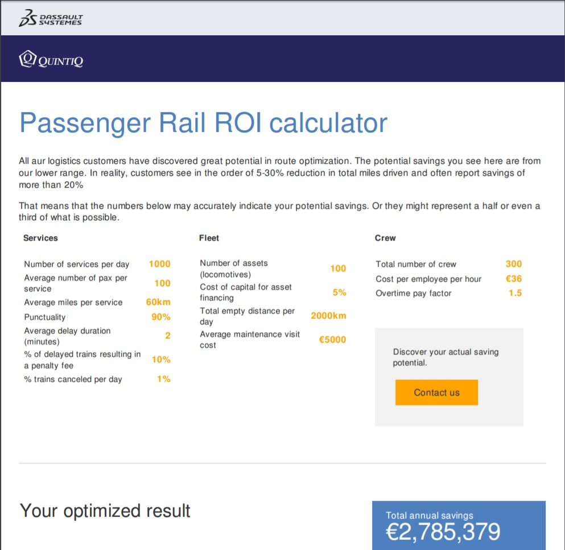
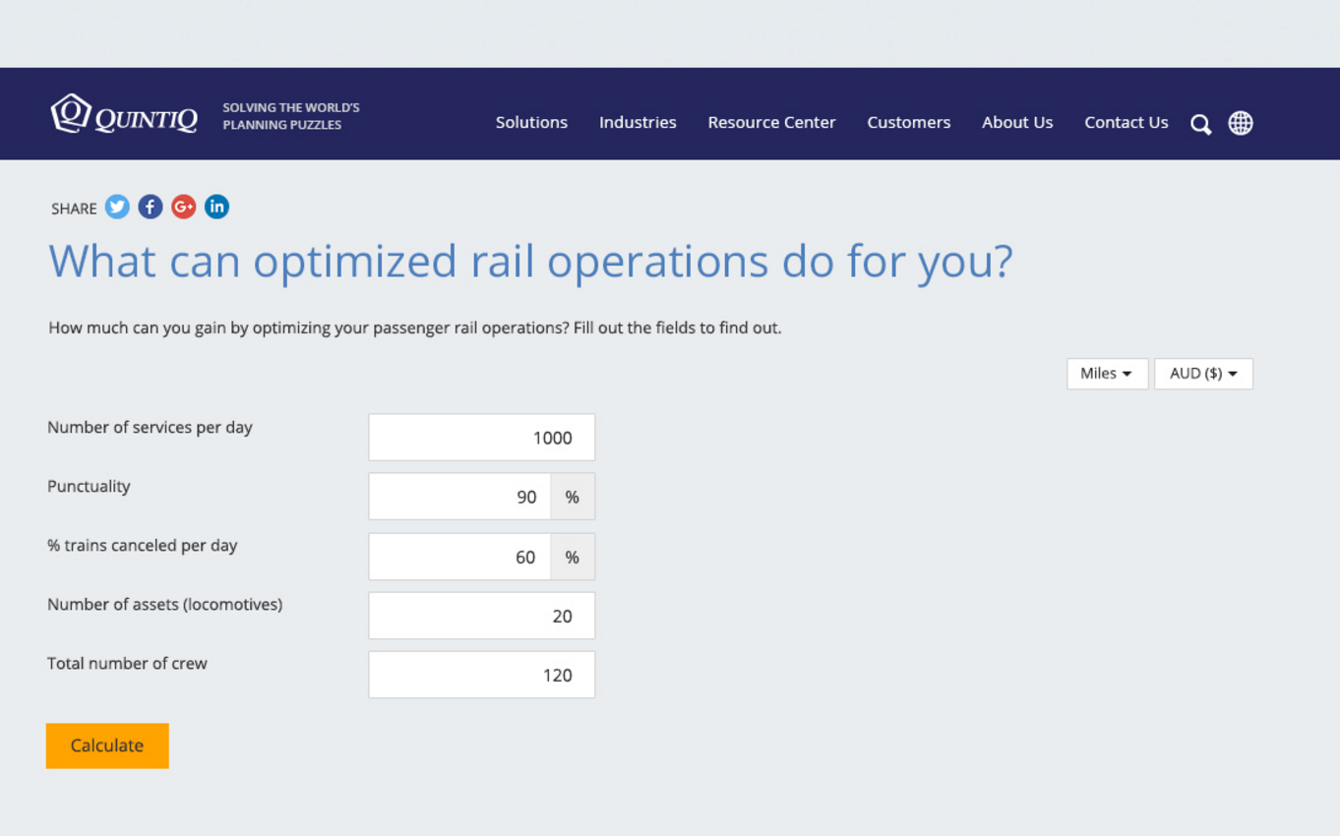
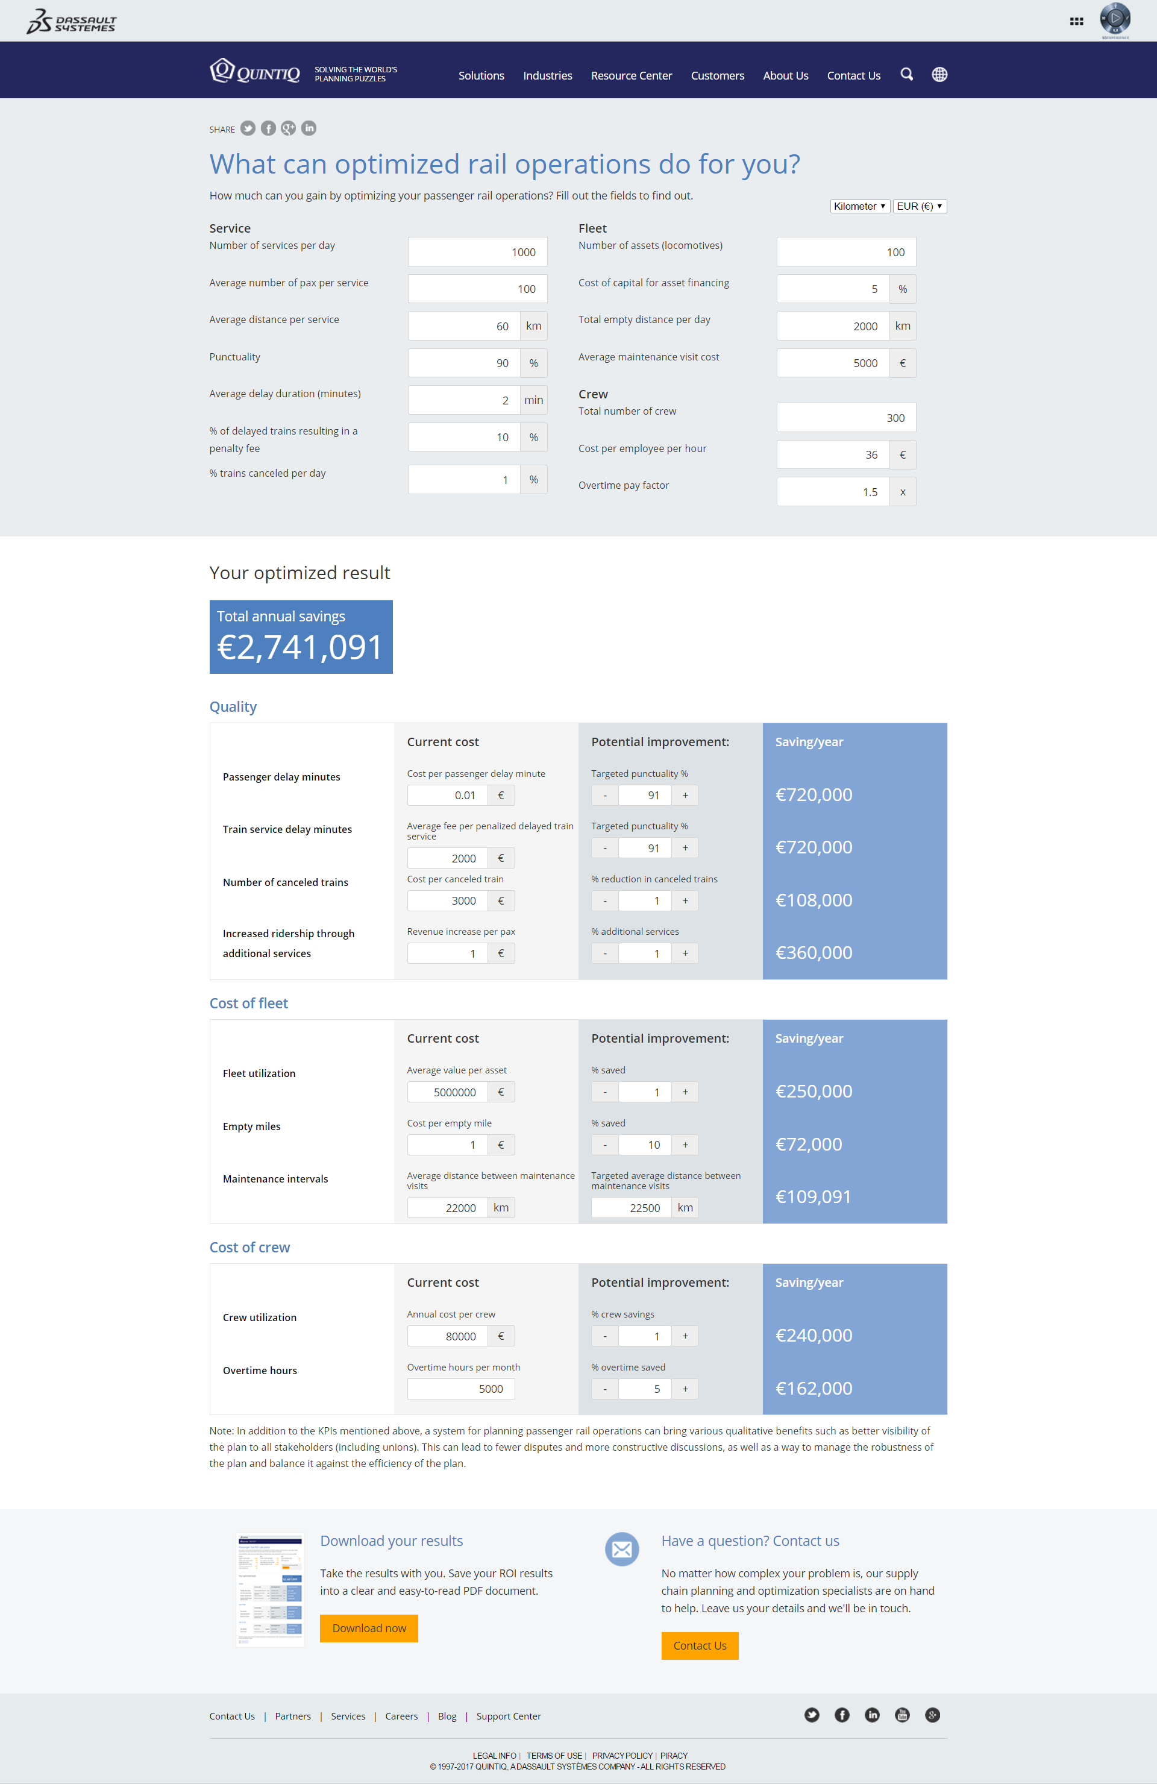
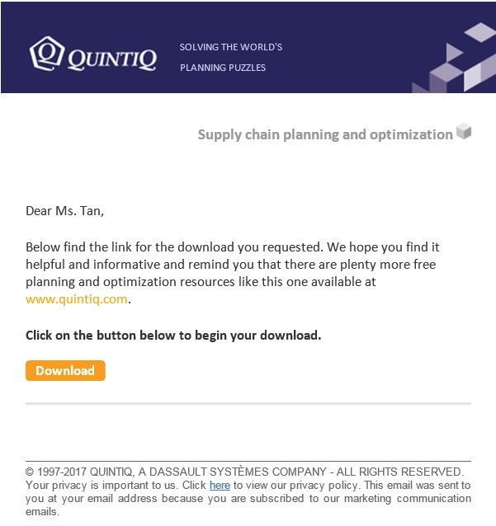
Current journey
CURRENT OPERATIONS
CTA: Calculate
TARGET IMPROVEMENT
CTA: Download detailed report
DOWNLOAD REPORT

Slide 2
Second phase
Web PDF report
Briefing
CURRENT OPERATIONS
TOTAL SAVINGS
CTA: Calculate
Total annual savings is $xxx,xxx,xxx with just 1% improvement in operations area of Quality, Cost of fleet and crew…
CTA: Continue to optimize.
Sales email campaign
Kind of analysis and consultancy description of the basic input that users key in upfront.
Persuasive
Information,
Quintiq intro
TARGET IMPROVEMENT ( Advanced calculator version)
CTA: Download detailed report
Navigate exact to the section of advanced calculator within the same page.
Alternatively, users can go ahead download the report for their circulation.
DETAILED REPORT’S CIRCULATION

Slide 3
Target users
C-level
Sales
Planners

